Slide 1
Web based Banking System in JAVA
Jialin Guo
3687827

Slide 2


GitHub：https://github.com/jialinGuo6/cs2043Project.git

Slide 3
CONTENTS
Introduction
01
Purpose & User
Draft
Requirements Analysis
02
Account Analysis
-- Personal & business
03
Design Diagram
Use case
UML
04
Design Class
Class relationship
Database Tables

Slide 4
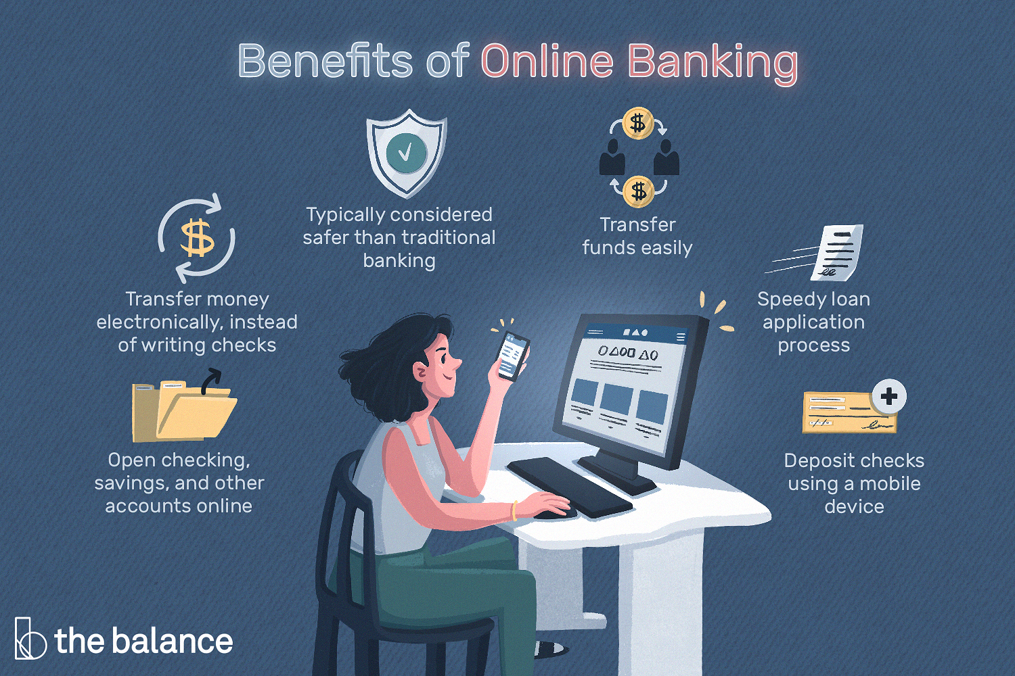

Slide 5
Introduction
Purpose
Users can use bank online
Reduce work
Save time & money
Check account at any time
User
individual bank user
company bank user

Slide 6
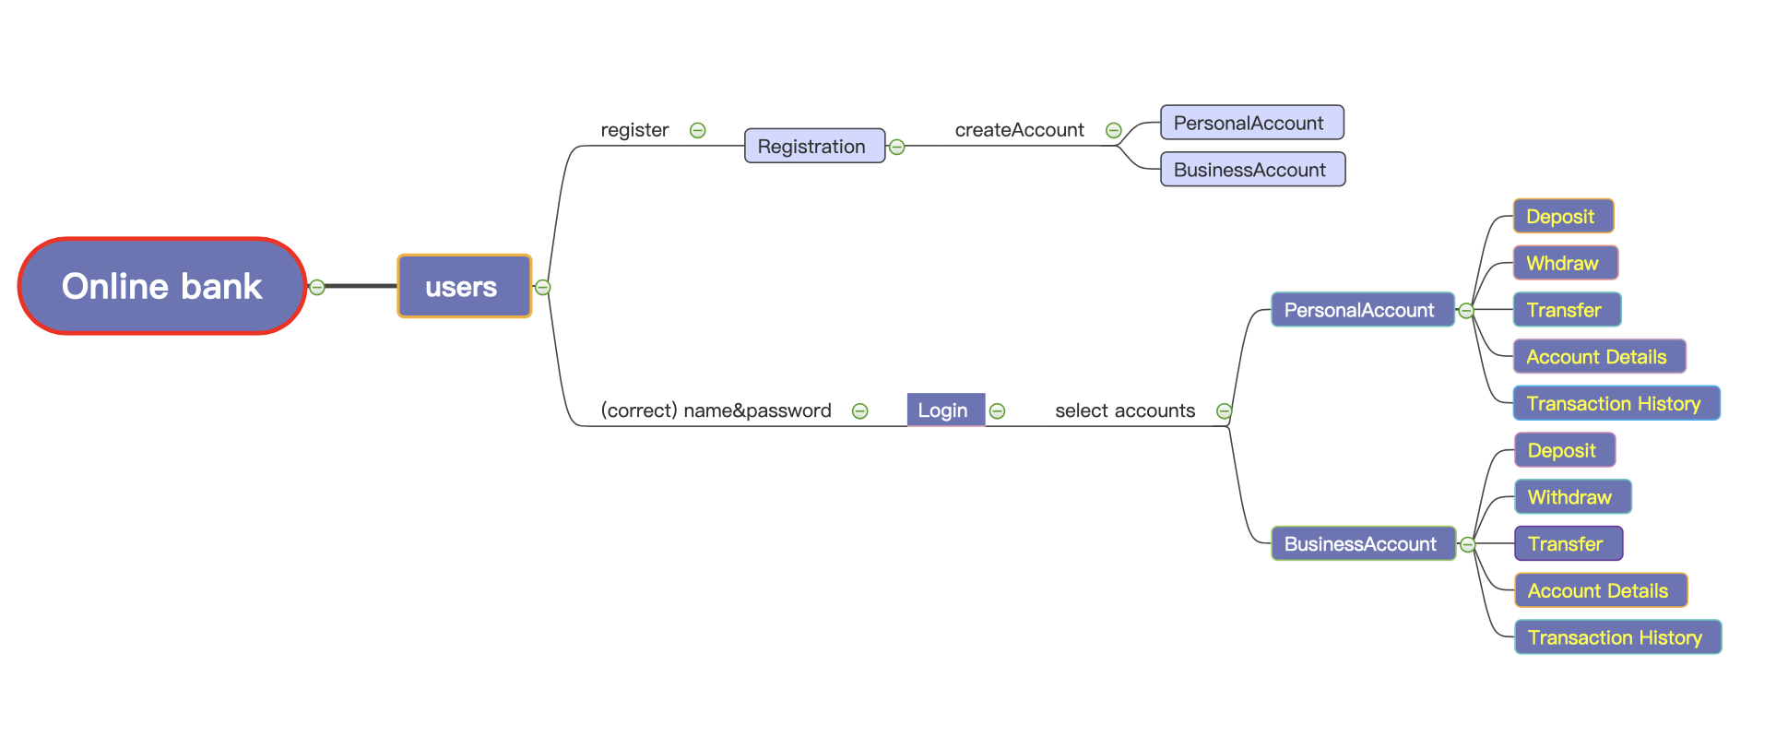
Draft

Slide 7
Requirements Analysis
Registration: User should has name and password to login, this is a process to store those two things before login.
Login: This is a process that users can use the system with the same name and password as them registered.
Option account: The user can select personal or busniess account.
Behavior：The user can deposit, withdraw or transfer cash, check account details and transaction history.

Slide 8

Account Analysis ———— Personal & business
Have different minimum transaction amounts
Use separately.
Users can have one type of account or both.
Same bank card with a user who has two type accounts.

Slide 9
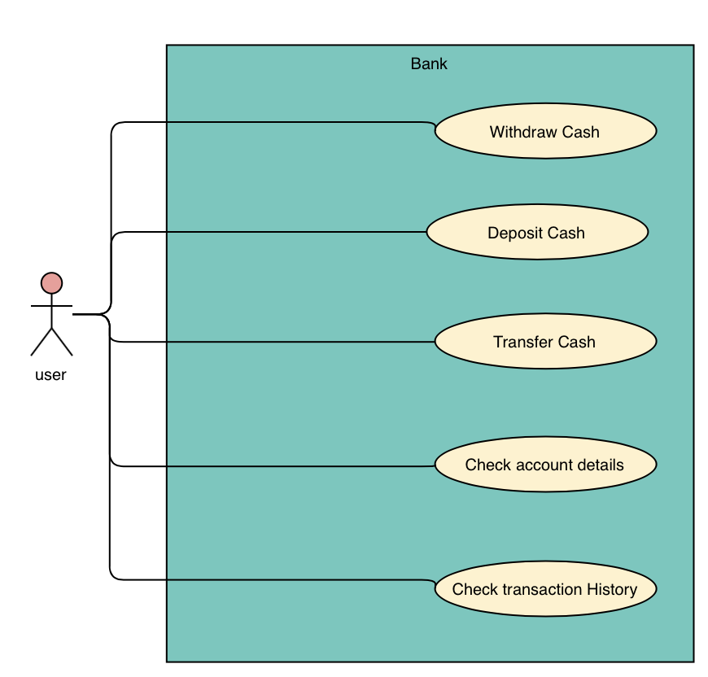
Use Case Diagram

Slide 10
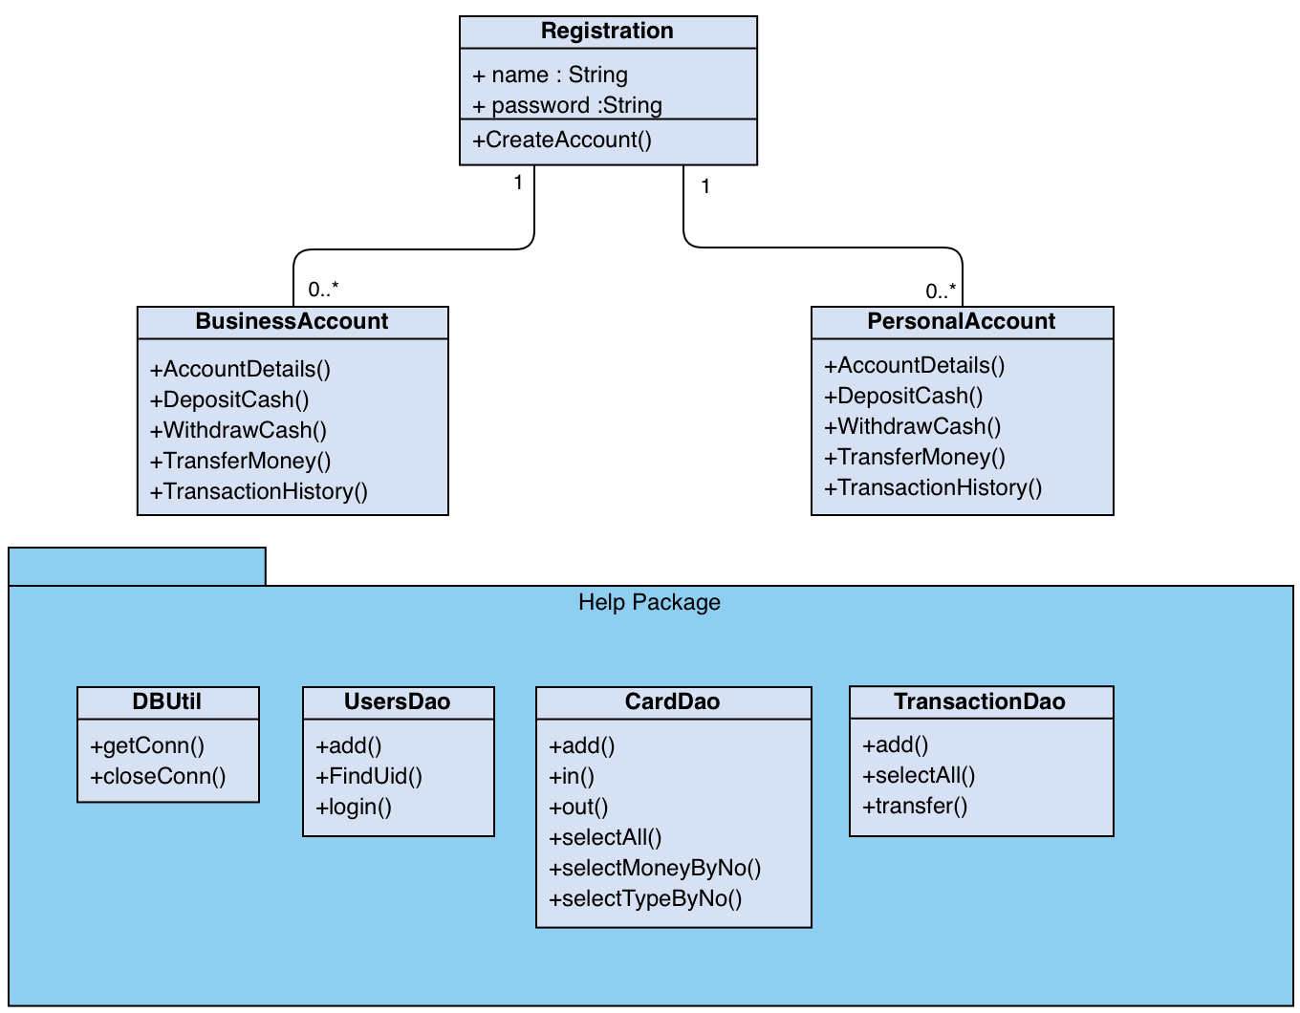
UML Diagram

Slide 11
Design Class
Database table: user, card, transcation
Bank Class: Registration, BusinessAccount, PersonalAccount,
Connection database class: UsersDao, CardDao, TranscationDao, DBUtil
Driver Class

Slide 12
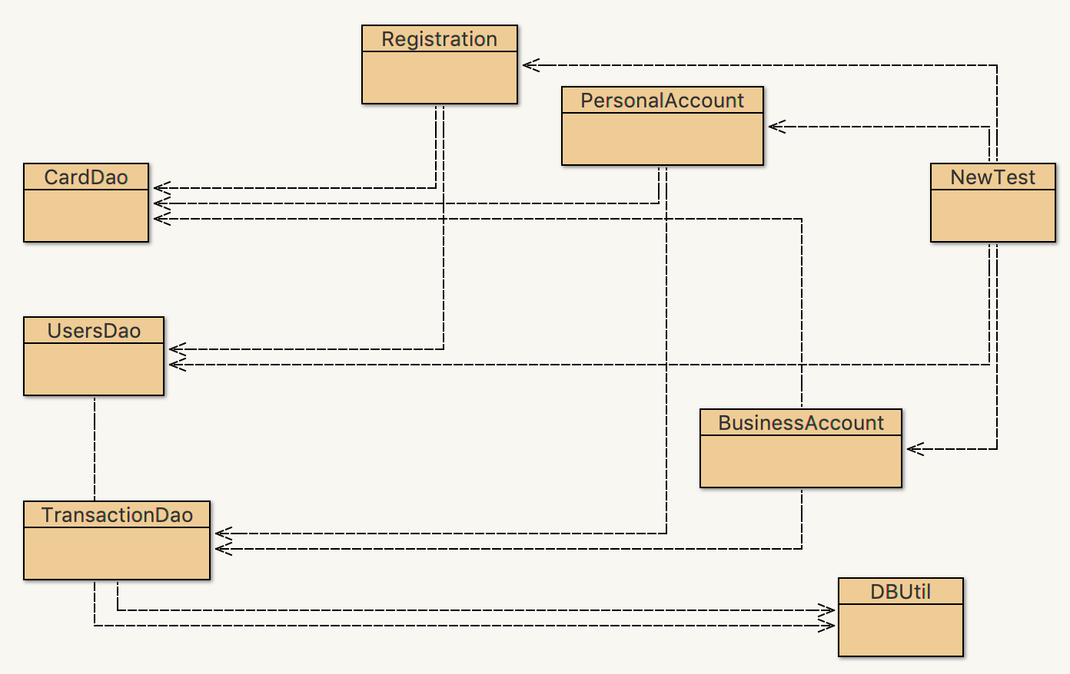
Class relationship

Slide 13
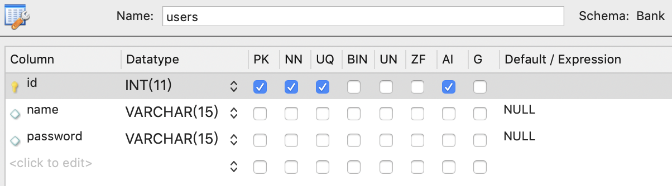
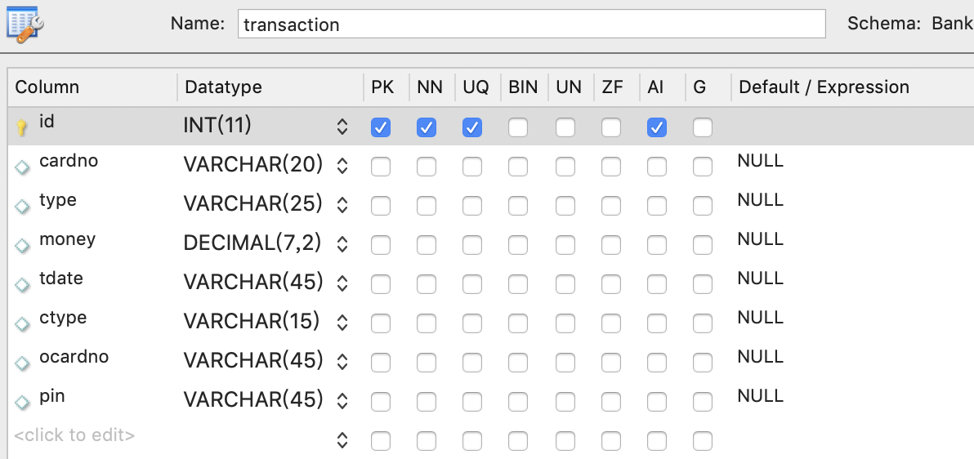
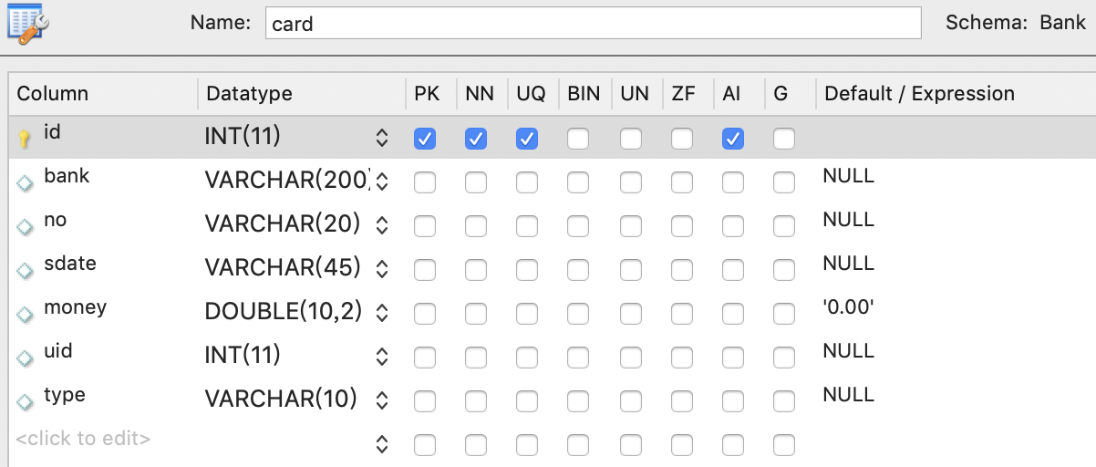
Database Tables Of Online Bank

Slide 14
THANKS

